Slide 1
Describing people
UNIT 3B

Slide 2

Agenda
Review: Family
Tricky words: Silent letters
Adjectives: Opposites
Adjectives: Describing people
Listening: Hand in my pocket

Slide 3

Learning objectives
The student will be able to describe their family members with details.
The student will be able to use technology vocabulary in settings.

Slide 4

Silent letters
Climb
Knee
Knit
Knot
Comb
Lamb

Slide 5

Matching exercise
A young sheep, or the flesh of a young sheep eaten as meet.
To make clothes, etc. by using two long needles to connect wool or another type of thread into joined rows.
To use your legs, or your legs and hands, to go up or onto the top of something.
A join made by tying together the ends of a piece or pieces of string, rope, cloth, etc.
The middle joint of the leg that allows the leg top bend.
A flat piece of plastic, used to tidy and arrange your hair.
Climb
Comb
Knee
Knit
Knot
Lamb

Slide 6
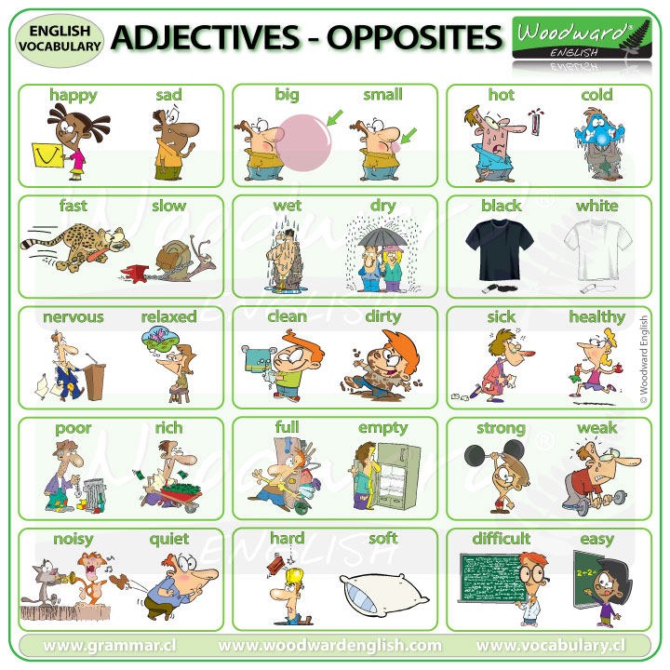
Adjectives I
What cities are cold in Colombia?
What animal is very fast?
Are you nervous at exams?
Which actor is strong?
Is noisy your neighborhood?

Slide 7
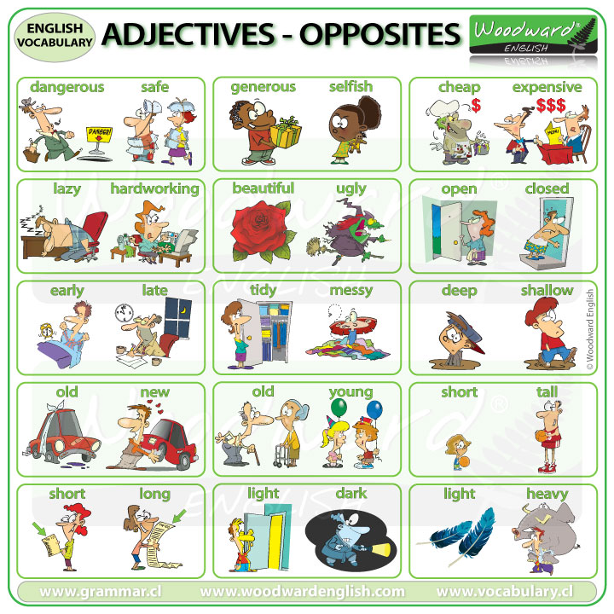
Adjectives II
Are you generous with people?
Who’s beautiful for you?
Are you a tidy person?
How old are you?
What food is light for you?

Slide 8
Adjectives: Describing people
Blonde
Curly
Straight
Bald
Ginger
Emma Bunton is _____.
Ed Sheeran’s hair is _____.
Beyonce’s hair is _____.
Lana has got _____ hair.
Vin Diesel is _____.
blonde
ginger
curly
straight
bald

Slide 9
Adjectives: Describing people
Fat
Unattractive
Handsome
Pretty
Thin
Charlize Theron is a _____ actress.
Leonardo Di Caprio is a ___________ actor.
Betty is an ___________ woman.
Stan Lauren was a _____ comedian.
Oliver Hardy was a _____ comedian.
pretty
handsome
unattractive
thin
fat
https://www.bookwidgets.com/play/uRVJToHY-iQAEKY6gfAAAA/KCH7GKB/adjectives?teacher_id=6363676981329920

Slide 10
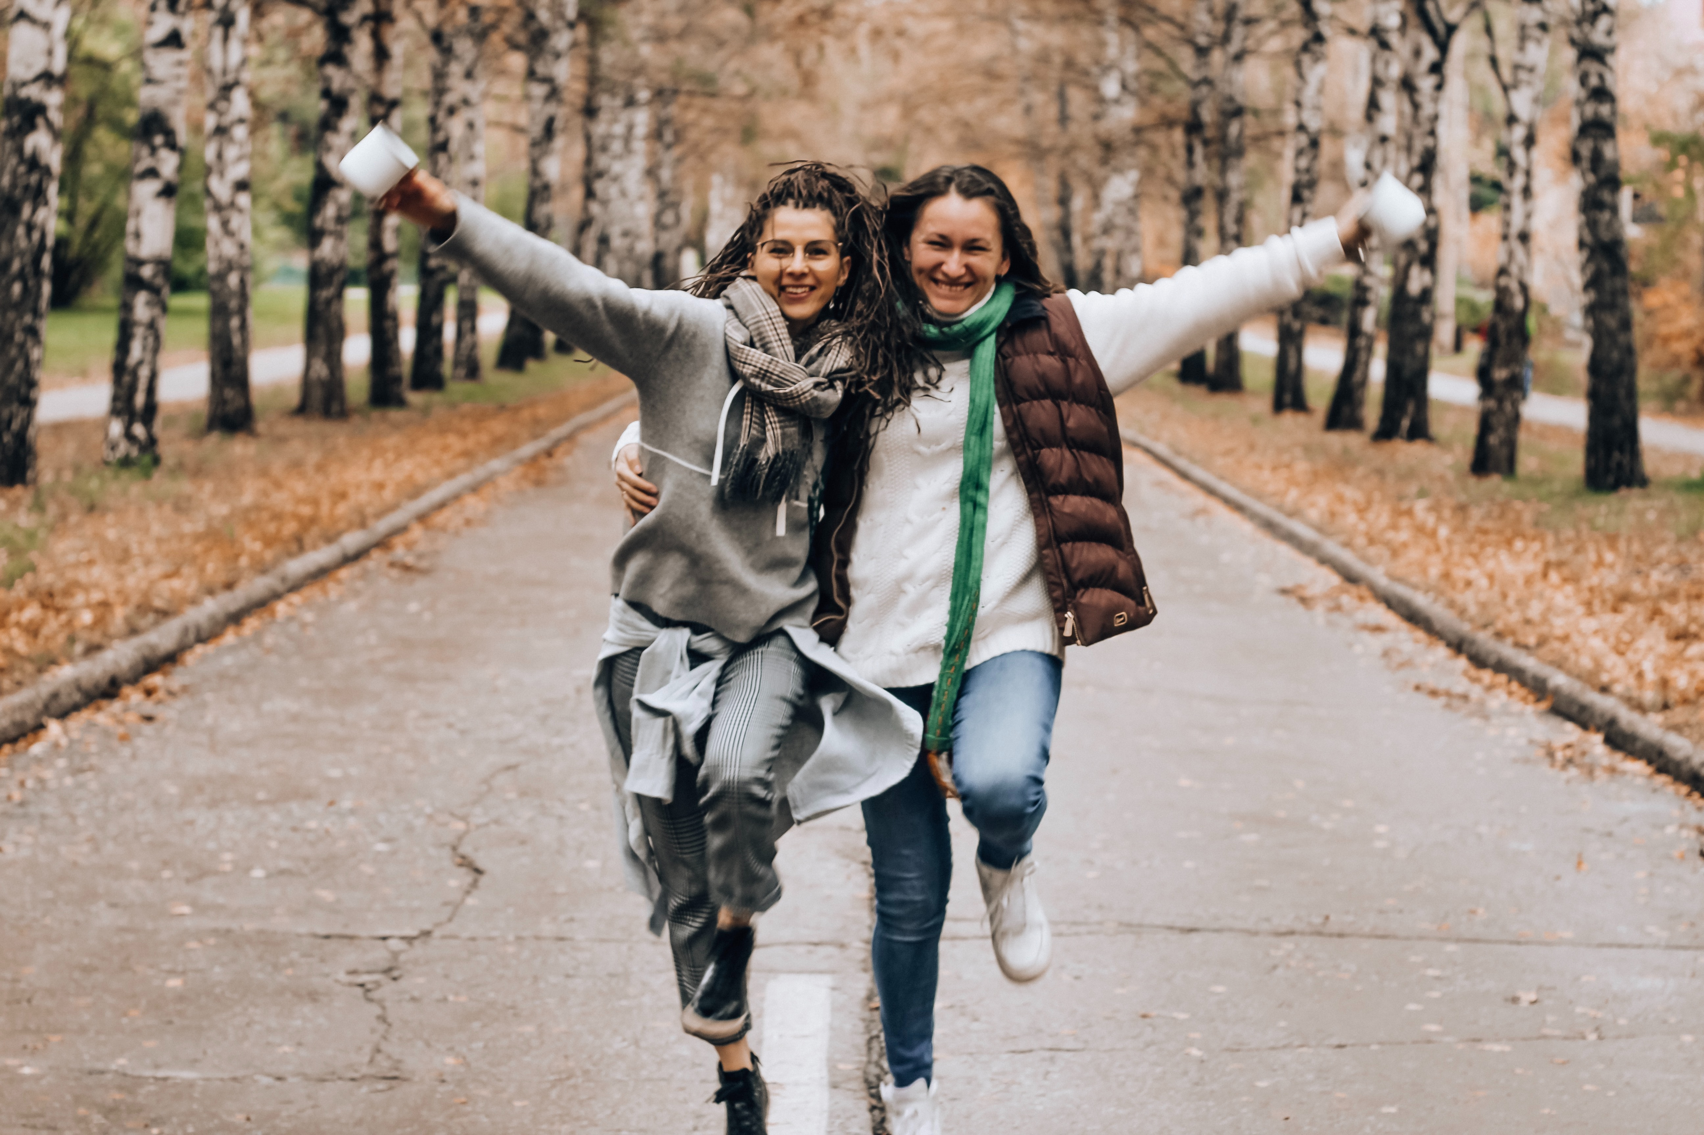

Listening: Describing people
Multiple choice.
Aurelia is asking about Hannah’s… boyfriend /brother /friend
Hannah’s brother, Jem has… long, brown hair /a girlfriend /a twin sister
Hannah has… one brother /two brothers /a brother and a sister
Alex and Jem… look different /look the same /have the same hair but different eyes
B. Gap fill.
That? Er, that’s my ________ Jem.
And that’s his girlfriend, Lucy. The ______ girl with the ____ , _______ hair.
Alex and Jem are ______. They’re both ____.
They’re exactly the same! They’re both _____ and _____.
They’ve both got ______, _______ hair, _____ eyes and ___ ears!
They’re not big. I think they’re ____!
brother
pretty
long
brown
----------
twins
15
tall
thin
----------
short
brown
green
-----------------
big
cute
-----------------
Council, B. (n.d.). Describing people. LearnEnglish Teens - British Council. https://learnenglishteens.britishcouncil.org/skills/listening/beginner-a1-listening/describing-people

Slide 11
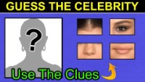
Guess who?

Slide 12
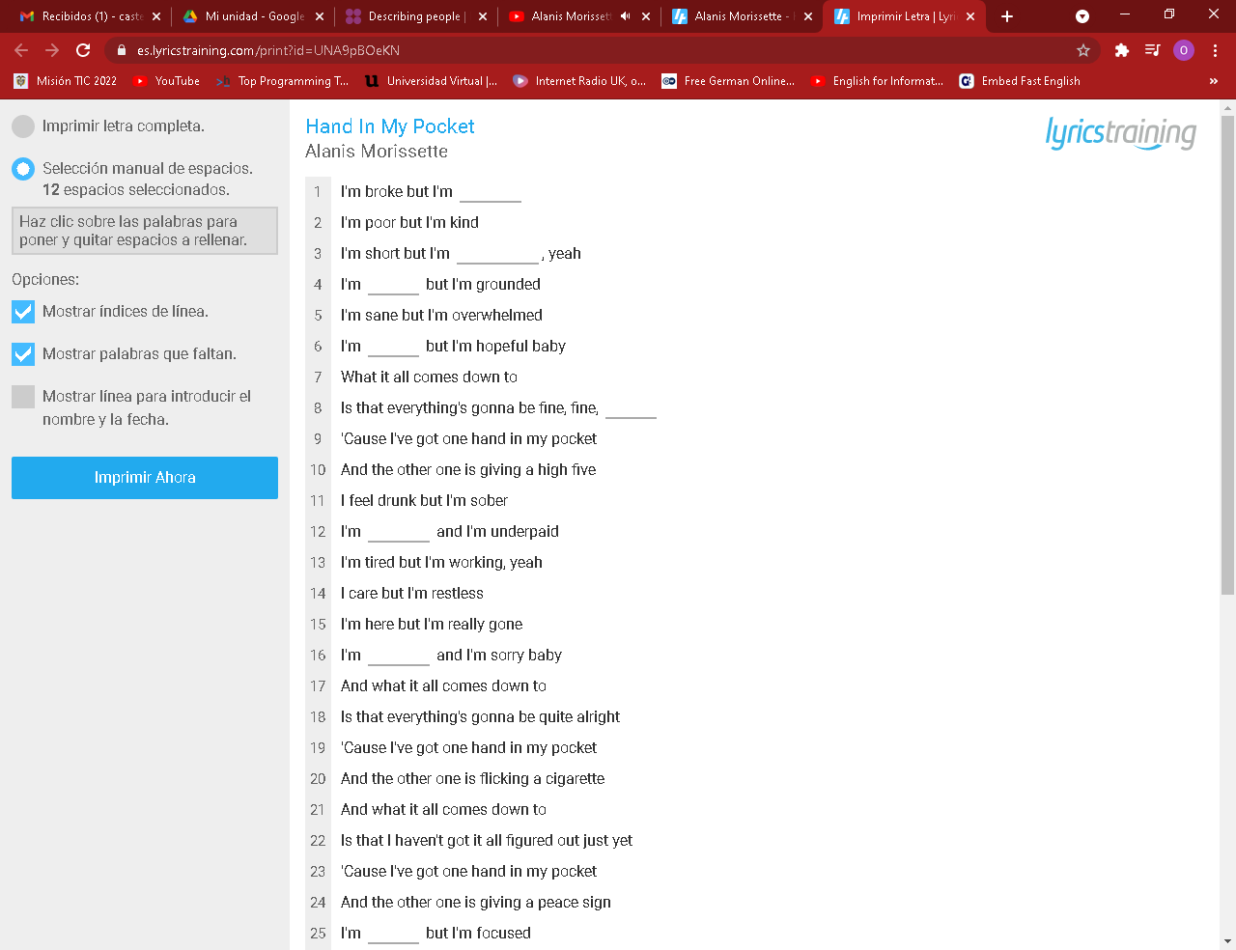
Hand in my pocket by Alanis Morissette
happy
healthy
young
high
lost
wrong
fine

Slide 13
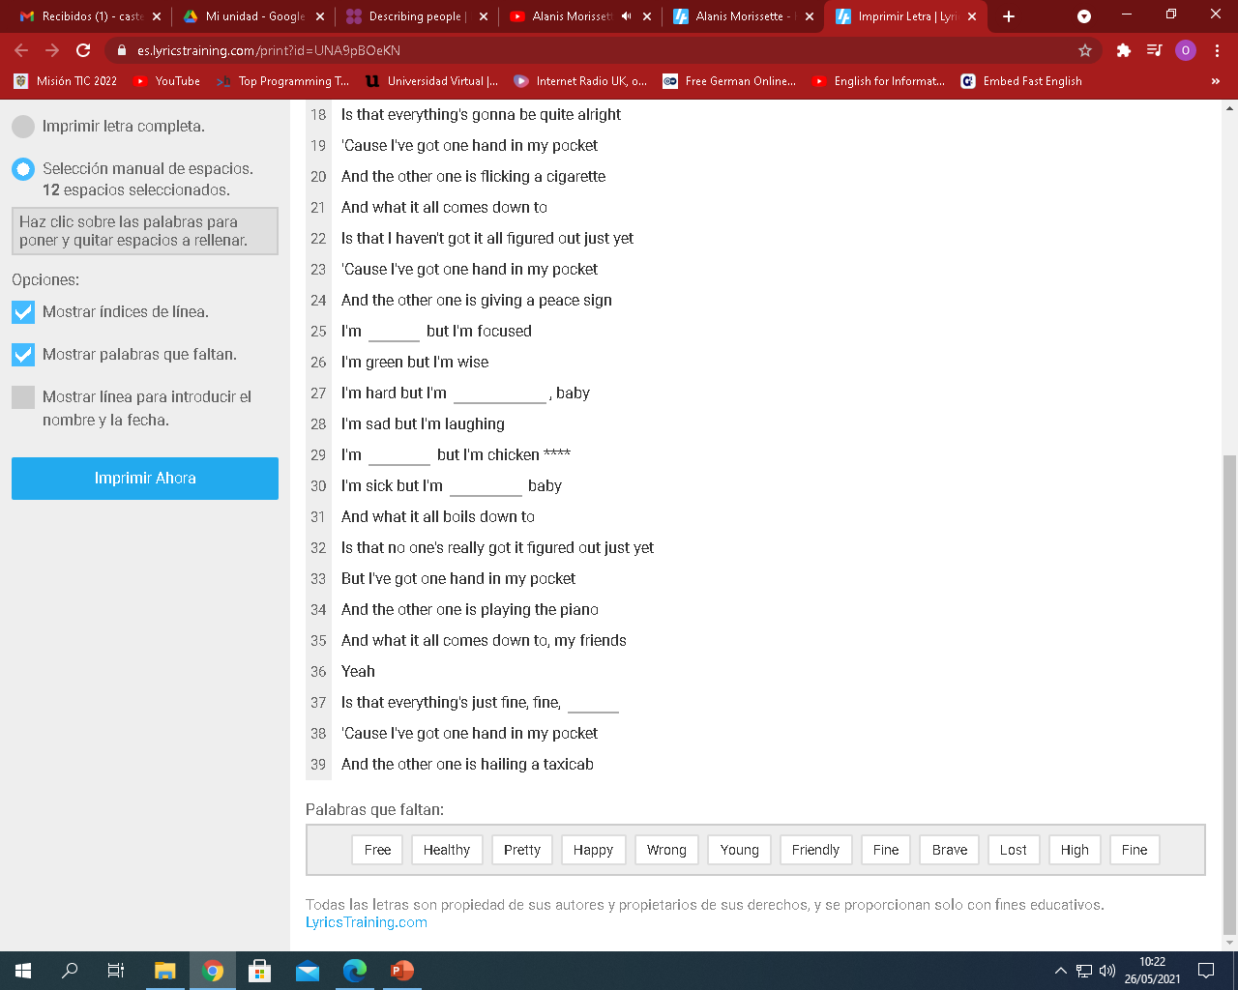
Hand in my pocket by Alanis Morissette
free
friendly
fine
brave
pretty

Slide 14
Vocabulary
Reading
WordBit
Learn English word reading
English tips

Slide 15


